Slide 1
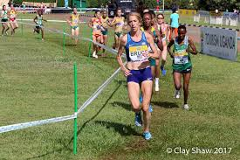
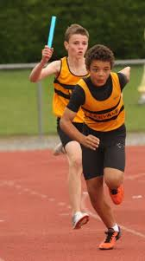
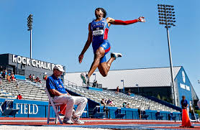
PIAA Track & Field/Cross Country Annual MANDATORY Rules Interpretation MEETING
Agenda
Rules Changes
Major Editorial Changes
Points of Emphasis

Slide 2
Welcome/Introductions
PURPOSE
To promote Safety, Fairness, and Consistency.
To provide a common understanding and application of NFHS T&F/CC Rules and PIAA Modifications.
To affirm the role of the Statewide Rules’ Interpreter and Chapter Rules’ Interpreters and review the Rules Interpretation/Question process:
Chapter Rules’ Interpreter >
Statewide Rules’ Interpreter > PIAA > NFHS
To review the process for Rule Changes/Modifications
2020 NFHS T&F/CC Rule Change Questionnaire (April)
CHAPTER LEVEL DECISION>PIAA>NFHS
2021 NFHS Rule Change Proposal Deadline (May 1)
PIAA T&F Steering Committee Meeting (June)
PIAA CC Steering Committee Meeting (January)

Slide 3
Submitting a rule change proposal
www.nfhs.org/RuleChangeProposal
Any submissions must be reviewed by the chapter rules’ interpreter prior to an official submitting an online Rule Change, using the link above.
Coordination with the statewide rules' interpreter is encouraged.

Slide 4
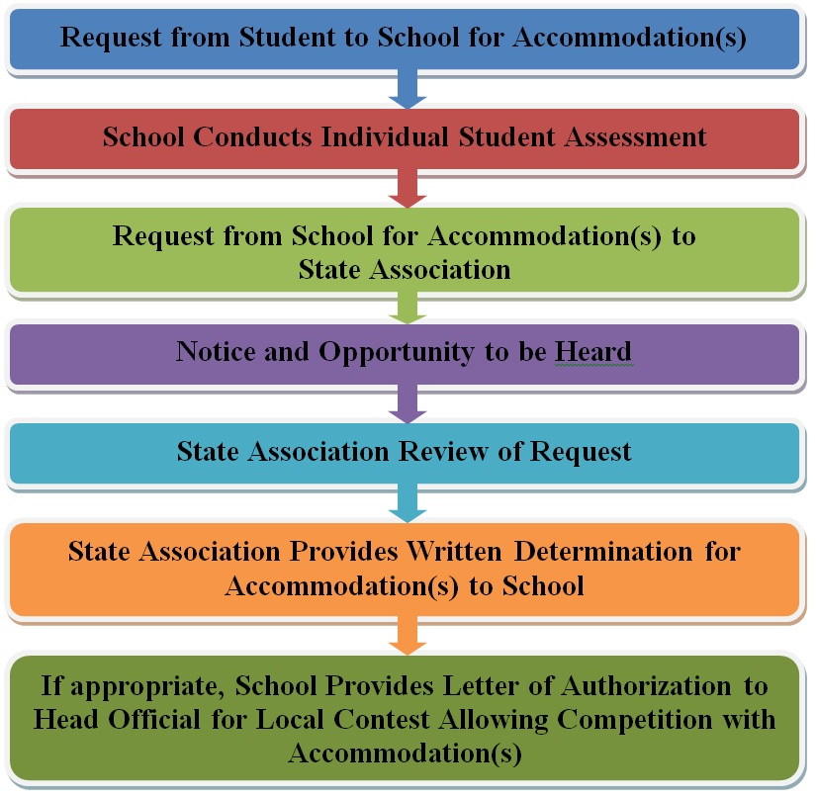
Guidelines for Schools and state associations for consideration of accommodations
Notes:
To assist state associations in working with schools for the inclusion of students with disabilities the following guide prepared by the NFHS Task Force on the Inclusion of Students with Disabilities is being provided for your review.
Following these guidelines will assist in the individual student assessment by the student and the school.
When requesting a possible accommodation, coaches should work with their school and the state association as early as possible in the sport season.
Contest officials shall defer decisions on rule accommodations to the respective state association.
This information serves as a guide. Each state association may develop its own process.

Slide 5
Rule Changes

Slide 6
Rules Changes
Rule 4-6-5g (Page 26)
Art. 5. . . It is an unfair act when a competitor receives any assistance. Assistance includes:
g. Competitor receiving assistance from another competitor to complete the race. Both competitors shall be disqualified unless a competitor is injured or becomes ill and an appropriate health-care professional is not readily available, only the injured/ill competitor is disqualified.

Slide 7
Rule 4-6-5g (Page 26) Continued
NOTE: Every attempt should be made for the appropriate health-care professionals to make these decisions as to assistance. A competitor who provides assistance to an injured or ill competitor should not be disqualified if neither the individual competitor providing the assistance nor his/her team gains an advantage as a result of providing the assistance.

Slide 8
Rule 8-6-1e1 and NOTE (Pages 69 & 70)
ART. 1 . . . A competitor is disqualified who:
e. Receives assistance from another competitor to complete the race.
1. Both competitors shall be disqualified unless a competitor is injured or become ill and an appropriate health-care professional is not readily available, only the injured/ill competitor is disqualified.
NOTE: Every attempt should be made for the appropriate health-care professionals to make these decisions as to assistance. A competitor who provides assistance to an injured or ill competitor should not be disqualified if neither the individual competitor providing the assistance nor his/her team gains an advantage as a result of providing the assistance.

Slide 9
Rationale for Rules 4-6-5g and 8-6-1e1
Rationale: The committee feels when no advantage is gained by a competitor helping a distressed or injured competitor, the competitor assisting should not be penalized for exhibiting good sportsmanship.
Rationale: When no advantage is gained by a competitor helping a distressed or injured competitor, the competitor assisting should not be penalized for exhibiting good sportsmanship providing neither they nor their team gamins an advantage as a result of providing assistance.

Slide 10
Rule 5-3-3 (Page 31) and Eliminated 5-3-4
ART. 3 . . . An exchange zone is designated for exchanging the baton during relay races.
It is an area the width of one lane and 20 or 30 meters long. The lines marking the limits of the exchange zone are included in these the 20-meter measurements. In relay races in which the incoming competitor is running 200 meters or less the exchange zone shall be extended 10 meters in the direction of the incoming competitor.
Renumbered succeeding articles

Slide 11
Other Rules Affected 5-10-6 thru 11 (Pages 38 & 39)
ART. 6 . . . Each competitor shall carry his/her own team’s the baton by hand throughout the race and shall pass it to the succeeding teammate. The first competitor shall start with the baton, and the last competitor shall carry the baton until he/she has finished the race. The baton must be passed while the baton is within the a 20-meter (66 feet) exchange zone. A baton that inadvertently leaves a runner's hand must be retrieved immediately without interference to other runners.
NOTE: In the 4x100-meter relay and 4x200-meter relay, and other relays with legs of 200 meters or less, each exchange zone in which the incoming competitor is running 200 meters or less will be 30 meters long. All exchange zones for races more than 200 meters will remain at 20 meters.

Slide 12
Other Rules Affected 5-10-6 thru 11 (Pages 38 & 39)
Art. 7 . . . The baton shall be handed from the incoming runner to the outgoing runner within the exchange zone. The passing of the baton commences when the baton is first touched by the outgoing runner and is completed when the baton is solely in the possession of the outgoing runner. If the baton is dropped in the exchange zone, in a legitimate attempt to hand it, either competitor may retrieve it, even from another lane, provided the competitor does not interfere with an opponent and the baton is retrieved within the limits of the original exchange zone extended across the track. If the baton is dropped outside the exchange zone, it must be retrieved by the competitor who dropped it.

Slide 13
Other Rules Affected 5-10-6 thru 11 (Pages 38 & 39)
ART. 9 10. . . In relay races where acceleration zones are not permitted, each outgoing competitor, while waiting for the baton, shall take a position entirely within the exchange passing zone and must complete the exchange while the baton is within the 20-meter exchange zone.
Art 10 11 . . .
Rationale: Brings NFHS track and field rules into conformity with other track and field rules codes. Tracks do not need to be repainted or resurfaced to comply with this rule change. The acceleration zone will now be incorporated into the exchange zone. Colored tape may be used to denote the exchange zones. Existing acceleration zone markings or colored tape may be used to denote the beginning of the exchange zone.

Slide 14
Other Rules Affected 5-10-6 thru 11 (Pages 38 & 39)
NOTE: In the 4x100-meter relay and 4x200-meter relay, and other relays with legs of 200 meters or less, each exchange zone in which the incoming competitor is running 200 meters or less will be 30 meters long. All exchange zones for races more than 200 meters will remain at 20 meters.

Slide 19
Exchange zones
Rationale: Aligns NFHS track and field rules with other track and field rules codes.
Tracks do not need to be repainted or resurfaced to comply with this rule change as the acceleration zone will now be incorporated into the exchange zone.
Colored tape may be used to denote the exchange zones.
Existing acceleration zone markings or colored tape may be used to denote the beginning of the exchange zone.
In the 4x100m and 4x200m, and other relays with legs of 200m or less, each exchange zone will be 30m long. All exchange zones for races over 200m will remain at 20m.
New 30 m Exchange Zone Layout
Available on the NFHS website: https://www.nfhs.org/media/1020307/20190730_asba_30m-new-exchange-zones_final.pdf

Slide 20
Rule 6-2-6 (Page 42)
Art. 6. . . Warm-ups should not be allowed unless supervised by an event official or the contestants coach and the venue has been declared open by the meet director. It is illegal to run backwards or in the opposite direction (non-legal direction) on a horizontal jump, pole vault, or javelin runway. At the conclusion of any field event there should be no further practice and implements, including vaulting poles, shall be removed from the area. Once a competition has begun, except as scheduled, competitors are not allowed to use for practice purposes the runway, ring, takeoff area or throwing implements associated with the competition.

Slide 21
Rule 6-2-6 (Page 42)
PENALTY: First offense shall result in a warning and, if repeated, disqualification from that event. If the incident recurs, the athlete will be disqualified from further competition in the meet.
Rationale: By not allowing athletes to run backwards or in the opposite direction on horizontal jumps, pole vault, and javelin runways, competitors will be more aware of their surroundings and the risk of injury will be minimized. This change also promotes a more organized and efficient warm-up period.

Slide 22
Rule 6-3-2b4(a) (Page 45)
Art. 2. . . When there is a tie at any distance or height of a field event, places and points scored shall be awarded as follows:
b. For places determined by height:
4. If the tie remains after applying (1) and (2) and:
(a.) It concerns first place; the competitors tying shall make one more attempt at the height at which they failed. If no decision is reached, the bar shall be lowered in increments of 1 inch (2 cm) in the high jump and 3 inches (7 cm) in the pole vault. If two or more of the tying contestants cleared the height, the bar shall be raised by intervals of 1 inch (2 cm) in the high jump and 3 inches (7 cm) in the pole vault. Each competitor shall attempt one trial at each height until a winner is determined.
Rationale: Provides appropriate metric increments for vertical jumps tie-breaking jump-offs.

Slide 23
Rule 6-9-5, NOTE, and 6-9-5a (Page 61)
ART. 5 . . . The landing pit shall have a minimum width of 9 feet (2.75 meters) and should meet a minimum length of 23 feet (7 meters).
Note: Pits constructed after 2019 shall be at least 23 feet (7 meters) in length.
a. In the long jump and triple jump, the foul line shall be located by measuring from the nearer edge of the landing pit to the front of the foul line.

Slide 24
Rule 6-9-5 (Page 61)
NOTE: Distance from the foul line or takeoff board may be adjusted to accommodate different levels of competition. Competitors may change which foul line or takeoff board they are using during competition, but only with the prior notification and confirmation of the event judge.

Slide 25
Rule 6-9-5 (Page 61)
Suggested distances are:
Boys Girls
Long Jump 12 feet (3.7 m) 8 feet (2.5 m)
Triple Jump 32 feet (9.8m) 24 feet (7.3 m)
Rationale: Clarifies the language of the 2019 rule change for long jump and triple jump landing pits and the intent of the change.
Language added back into book for suggested distances for take-off board/foul line.

Slide 26
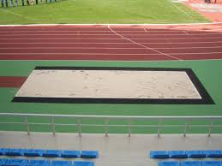
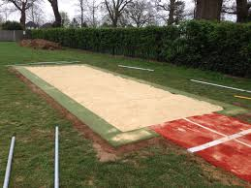
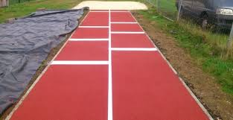
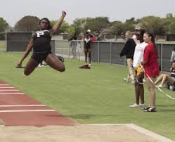
Jump pits constructed after 2019, the length of the pit shall be at least 23 feet (7 meters). The distance from the foul line or takeoff board may be adjusted to accommodate different levels of competition.

Slide 27
Rule 8-1-1 (Page 63)
ART. 1 . . . The cross country course shall be 2,500 to 5,000 meters (1.5 to 3.1 miles) in length as determined by the meet director or games committee. Measurement shall be along the shortest possible route a runner may take on the prescribed course.
The course shall be clearly marked using one or more of the following methods:
a. A single wide line or boundary lines, both inside and outside, marked with a material which is not injurious to the eyes or skin; b. The use of natural or artificial boundary markers; or
c. Signposts with large directional arrows wherever the course turns, or flags about 1-foot square and mounted on stakes which hold them 6 feet or more above the ground.

Slide 28
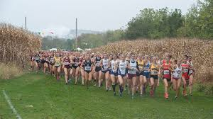
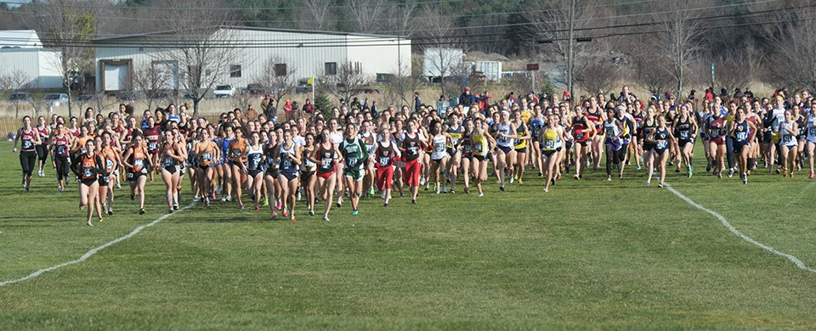

Slide 29
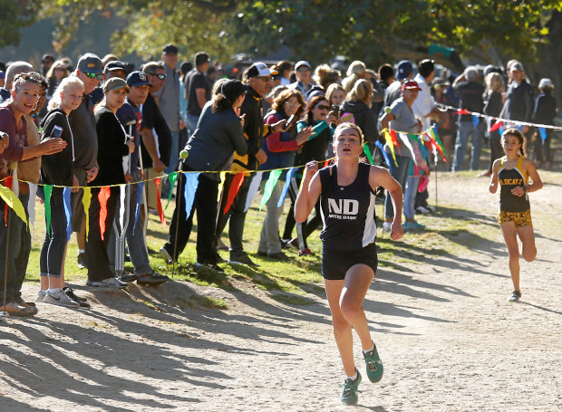
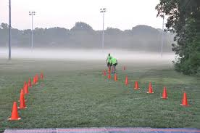
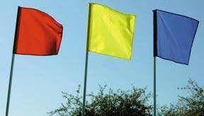

Slide 30
Rule 8-1-1 (Pages 63 & 64)
NOTE: If a single wide line is used, it may or may not mark the shortest possible route that a runner may take.
FLAG DESIGNATIONS
• A red flag indicates a turn to the left. Runners must stay on the right side of the flag.
• A yellow flag indicates a turn to the right. Runners must stay on the left side of the flag.
• A blue flag indicates a course straight ahead. Runners may run on either side of the flag.
ART. 2 . . . In case of a discrepancy in the course markings, directional flag markings and cones take precedence over any other course markings.
Rationale: The reorganization of the rule defines that a course should be clearly marked with any or all of the methods listed in the rule.

Slide 31
Rule 8-1-3a (Page 64)
ART. 3 . . . The race course should include the following features:
a. Signs and flags at least 6 feet above the ground visible for 100 feet. Turns and guidelines should be marked on the ground with a material which is not injurious to the eyes or skin. The course should be at least 3 feet (1 meter) wide at its narrowest place. No narrow section should be longer than 10 feet (3 meters) long. Small survey flags or cones at least 12 inches (30 cm) high of the appropriate color may be used in lieu of painted lines or survey chalk.

Slide 32
Rule 8-1-3d and 8-1-3e NOTE (Page 64)
d. At the beginning of the course, there may be a straightaway of at least 100 meters before any significant turns.
e. At the end of the course, . . .
NOTE: For large meets, the use of multiple chutes is recommended. Where video timing is used and pull tags are not, the use of a large corral with a single exit point should be used instead of finish chutes.
Rationale: This rule change will not eliminate courses that may be used for smaller meets with limited numbers of participants. The additional language for a suggested straight away at the start provides a recommendation for a minimum distance at all meets.

Slide 33
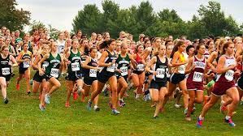
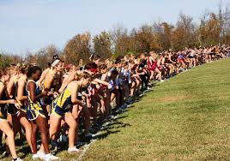
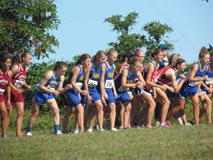

Slide 34
Editorial Changes

Slide 35
Rule 5-1-5 (Page 27)
Art. 5. . . It When feasible, is recommended that there be an obstacle-free zone on the inside and on the outside of the track at least 1 meter in width.
Rationale: Redundant language
Rule 5-11-1 (Page 39)
Art. 1. . . A relay team shall pass its the baton in accordance with the rules. The track rules relative to fouling, coaching or interference apply identically to relay races. Also, incoming competitors may not assist teammates by pushing them.
Rationale: Clarifies that a team finishes the race with the same baton that it used at the start of the race.

Slide 36
Rule 5-10-6 and note (Page 38)
ART. 6 . . . Each competitor shall carry his/her own team’s the baton by hand throughout the race and shall pass it to the succeeding teammate. The first competitor shall start with the baton, and the last competitor shall carry the baton until he/she has finished the race. The baton must be passed while the baton is within the a 20-meter (66 feet) exchange zone. A baton that inadvertently leaves a runner's hand must be retrieved immediately without interference to other runners.
NOTE: In the 4x100-meter relay and 4x200-meter relay, and other relays with legs of 200 meters or less, each exchange zone in which the incoming competitor is running 200 meters or less will be 30 meters long. All exchange zones for races more than 200 meters will remain at 20 meters.

Slide 37
Rule 6-8-10d Javelin Throw (Page 60)
Art. 10 . . It is foul if the competitor
d. Touches on or over either the runway lines or on or over the foul-line arc before the throw has landed is marked.
f. Exits the runway before the implement has landed
g. Fails to exit the runway behind the foul-line arc and the perpendicular side extensions after the javelin has landed.
Rationale: Clarifies language permitting an athlete to exit the runway after the implement has landed and before it is marked.

Slide 38
Corrections: RuleS & Case Books
Rules Book – Page 12 Rule 3-2-3 . . . The games committee has the authority to determine the:
h. Type of markings Approved items (tape, chalk, half tennis balls, etc.) and the locations outside the exchange in the acceleration zones of all relay races run in lanes.
Case Book – Page 12 3.2.4 Situation H …Team A wishes to place a mark on the track outside the exchange acceleration zone to aid the outgoing …
Case Book – Page 54 5.10.7 Situation B … ,but within the exchange acceleration zone while A2 remained within the assigned acceleration and exchange lane and zone.

Slide 39
2020 Points of Emphasis
1. Meet Administration
2. Assisting Injured Athletes
3. Exchange Zones

Slide 40
Meet Administration
Providing a quality experience to track and field athletes, coaches, and spectators does not happen by accident. Many months of pre-planning and execution have occurred before the event is finalized and the first event begins.
Most standardized checklists include foundational topics such as: establishing entry limitations and substitution deadlines, securing meet personnel, developing a meet schedule, and preparing the facility to host the event. Quality meet administrators know and understand that while covering these essential items is certainly necessary and appropriate, the ability to drill down to the smallest details is equally important and critical for ensuring success.
While not included on most checklists, pay special attention to the following items as they can dictate the success or failure of your event:
Notes:
Meet administration is crucial to running of any track and field meet.
Months of pre-planning, checklists which include entry limits, substitution deadlines, securing meet personnel, developing a schedule and preparing the facility are a few of the items necessary for any meet.
The small details are critical to ensuring success.

Slide 41
Meet administration
NFHS Rule 3-1-1 gives authority to the meet director to establish a custodian of awards. Double check prior to your event that the appropriate awards have been ordered and are available. This critical step will save you embarrassment in the moments and time after the event.
NFHS Rule 3-4-7 allows the meet referee the authority to delegate the responsibility of counting laps for any race of two laps or more. Whomever is assigned to this duty must be confident and knowledgeable regarding counting laps and the likelihood of dealing with the potential for lapped runners. This is not a duty for a novice official or volunteer.
NFHS Rule 3-5-3 outlines the situations that are eligible to protest/appeal. It is imperative that coaches understand the appeal structure and its available options. Having a clear and concise protocol that is delineated to coaches prior to the start of the event will pay benefits.
NFHS Rule 3-18-3 designates the responsibility for ensuring that each flight of hurdles is set at proper height and prescribed point prior to each race. While moving hurdles on-and-off the track efficiently is essential, the system used to double check height and placement is also critical.
NFHS Rule 3-18-4 outlines the responsibilities of the block chief. Assigning an individual(s) responsible to ensure that starting blocks are in good working order, are located at the starting line of each race, and removed after the start is one less responsibility usually placed on the starter or assistant starter.
NFHS Rule 5-11-1 requires that in any relay race, a team must start and end the race with the same baton. Meet administrators should consider a system (color, number, etc.) that, if necessary, can assist officials in determining that the correct baton has been used by any team finishing a race.
NFHS Rule 6-5-3 dictates that state associations determine their own procedures regarding verification that a pole vaulter participates on a legal pole. For those states that use some type of on-site weigh-in procedure for this verification process, it is important that the scale used to determine body weight is certified as accurate considering it will determine which pole(s) the athlete is eligible to use during the competition.
Putting on a quality track and field event is not easy.
Do not let addressing the most obvious elements overshadow the less obvious during your planning.
Notes:
Within the NFHS rules book the following rules help assist in the planning of a meet.

Slide 42
Exchange zone
In sprint relays such as the 4x100 meter and 4x200 meter, and other relays with legs of 200 meter or less, the outgoing runner, while waiting for the baton, must be positioned entirely inside the 30-meter exchange zone.
The exchange zones for relay races with legs over 200m are not impacted by this rule change.
The rule change does not require that tracks be repainted or resurfaced in order to be in compliance with NFHS rules.

Slide 43
Assisting injured athletes
The competitor who receives aid will be disqualified, but when no advantage is gained the competitor assisting should not be penalized for exhibiting good sportsmanship.
The final decision in these situations’ rests with the meet referee who has sole authority to rule on infractions, irregularities, and disqualifications in a meet.
Notes:
Ultimately when a competitor stops to offer assistance in track and field and cross country, and no health care professional is readily available,
the competitor offering aid is not disqualified when no advantage is gained by the competitor or the competitor’s team.
The competitor receiving assistance is always disqualified.

Slide 44
Questions

Slide 45
PIAA Modifications
Adopted the portion of NFHS Track & Field/Cross Country Rule 8-2-3 (page 65) that authorizes Conferences or Leagues to modify the scoring system when less than five (5) competitors of a team finish in dual meet competition, effective July 1, 2019.

Slide 46
Modified CC Scoring
Just to be clear “Modified Scoring” in a CC Meet can only be done in our State if a Conference/League/District, prior to the first regular season contest date, approves the use of the modified scoring system due to the fact the teams in their have less than 5 runners making up their team.
Two schools cannot just decide to use it halfway through or at the end of the season due to low numbers unless that decision was made by the conference/league before the start of the regular season. Finally, modified CC scoring is only for regular season Meets and NOT Invitationals/League Championships/District Championships.

Slide 47
Modified CC Scoring
If a team has less than 5 runners or both teams have less than 5 runners is the only time the “modified scoring” procedure would be used.
Scenarios:
Team A has 4 runners and Team B has 4 runners – the Meet would be scored using the finishing places of the 8 runners only. ( There would be 36 points to be awarded and there would be NO displacers.)
Team A has 3 runners and Team B has 3 runners – the Meet would be scored using the finishing places of the 6 runners. (There would be 21 points to be awarded and there would be NO displacers)
Team A has 4 runners and Team B has 3 runners- - The 7 runners that run the race would be awarded places 1 thru 7 (NO Displacers). Team B would be credited with a ghost runners and would be awarded 8th place.
Team A has 2 runners and Team B has 3 runners – the 5 runners that run and finish the race would be awarded places 1 thru 5 (No displacers). Team A would be credited with a ghost runner and be awarded 6 points for a 6th place finish.
Team C has 6 runners and Team D has 4 runners – Assuming all of Team D’s runners finished ahead of Team’s C sixth runner that runner would be a displacer and Team D would be credited with a ghost runner that finished the race in 11th place. In any case Team C would have a displacer and the Team D would still need to be credited with a ghost runner in 11th place.
Team E has at least 7 runners and Team F has 4 runners – Team E would have 2 runners that would be displacers and Team F would have a ghost runner that finished 12th added to their team score.

Slide 48
Reminder!!
Starting with the 2019 PIAA-defined Cross Country Season a PIAA-Registered T&F/CC Official will be required for All High School Varsity Meets.
Starting also with the 2019 PIAA-defined Cross Country Season it will be recommended that a PIAA-Registered T&F/CC Official be used during Jr. High/MS Meets, but is NOT required.

Slide 49
PIAA modification
Rule 3-2-4n (pg. 13) PIAA modification restricts the wearing of caps, hats, do-rags etc. unless approved by PIAA for medical reasons.
Rule 4-4 NOTE (pg. 24) Knit or stocking hats may be worn in cold weather with Games Committee approval.

Slide 50
Reminder/QUESTIONS
Reminder: 26th Annual Officials Convention will be held at the Harrisburg Hilton on August 7and 8, 2020.
Questions:

